Slide 1
Big Mountain Ski Resort Data Analysis Project
Jimmy Thelisma

Slide 2
Problem Identification
Big Mountain Ski Resort currently does not utilize their facilities as well as they can and are leaving revenue on the table
They want to install a new chair lift which will cost $1.54 million
Initial investigation has shown they do not optimally charge for tickets, which are currently priced at $81

Slide 3
Data Walkthrough
Big Mountain was provided with a spreadsheet of facility and pricing information from 330 other resorts around the country
It includes information on the locations of the resorts, what amenities are available, and how much they charge for tickets

Slide 4
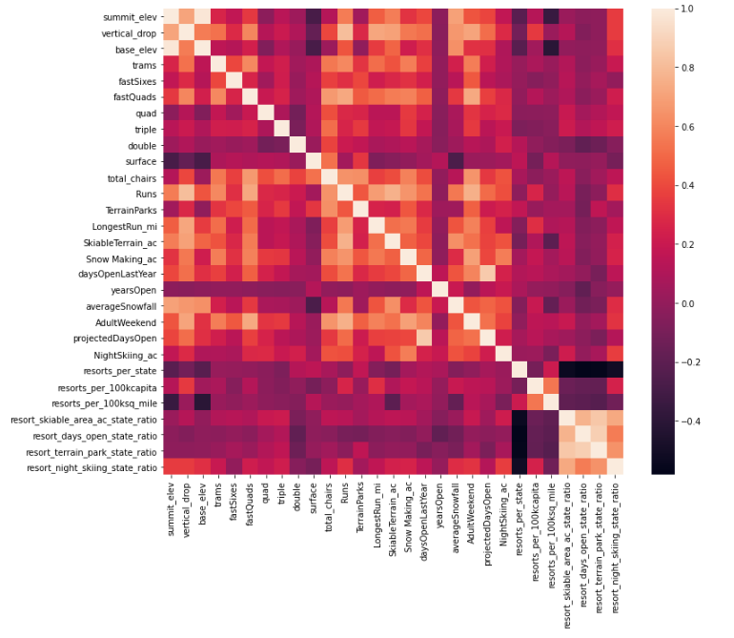
Key Findings
fastQuads, total Runs, snow making, and resort night skiing were all variables that were highly correlated with the Adult Weekend Ticket Price
A Random Forest Model was found to have a lower cross-validation MEA by almost $1 and exhibits less variability

Slide 5
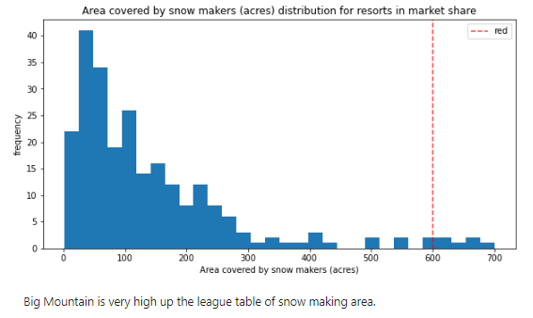
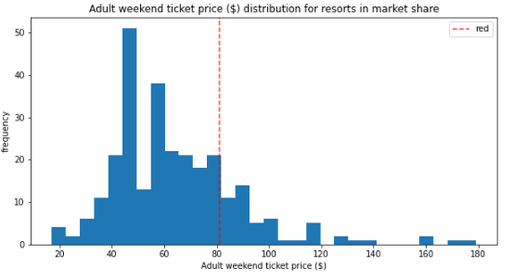
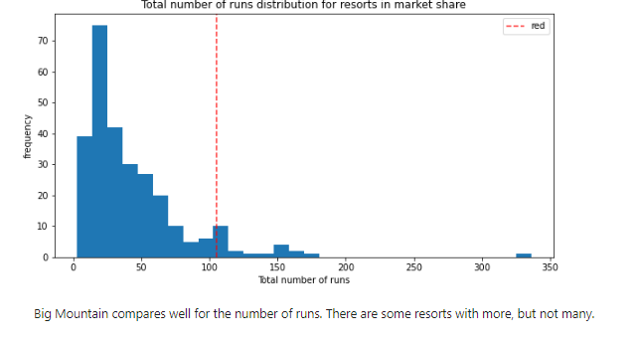
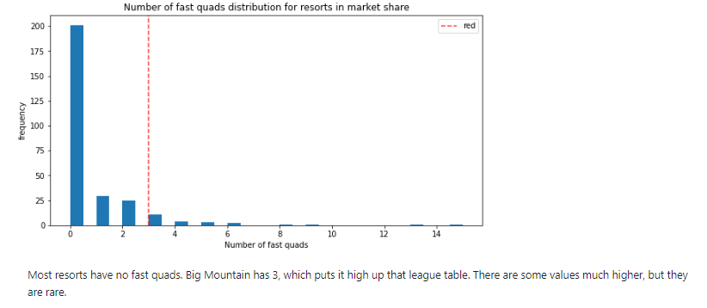
Modeling Results and Analysis
We can see that while Big Mountain ranks on the higher range of amenities that have high correlation with ticket prices, it falls closer to the median of ticket prices for all resorts

Slide 6
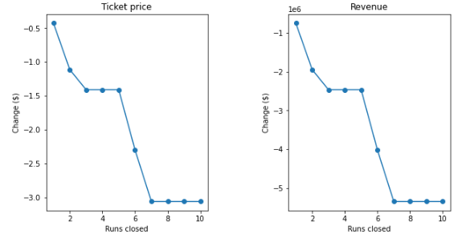
Modeling Results and Analysis
The model says closing one run makes no difference. Closing 2 and 3 successively reduces support for ticket price and so revenue. If Big Mountain closes down 3 runs, it seems they may as well close down 4 or 5 as there's no further loss in ticket price. Increasing the closures down to 6 or more leads to a large drop.

Slide 7
Modeling Results and Analysis
Scenario 2:
The addition of a new run, increasing the vertical drop by 150 feet, and installing an additional chair lift increased support for ticket prices by $0.83
This would translate to an increase in revenue over the course of the season by $1458333
Scenario 3:
Same as Scenario 2 but with an added 2 acres of snow making did not make any difference on supporting ticket prices vs the original second scenario
Scenario 4:
Increasing the longest run by 0.2 miles and guaranteeing its snow coverage by adding 4 acres of snow making predicts no increased support for ticket prices either

Slide 8
Recommendations
Big Mountain Resort has a modelled ticket price of $95.20 with an actual price of $81.00. Even with the expected mean absolute error of $10.45, it suggests there is room for an increase.
Closing 5 runs per day would save on operation costs
The addition of a new run, increasing the vertical drop by 150 feet, and installing an additional chair lift increased support for ticket prices by $0.83

Slide 9
Summary and Conclusion
The data suggests that Big Mountain has the amenities to support increased ticket pricing
For further analysis, expanding on the existing dataset would be helpful. The only pricing information available is for tickets, obtaining data on operating costs for Big Mountain and other resorts would provide another way to analyze potential areas to save money and expand pricing

